Slide 1

3D Modeling Basics
What is 3DM (DTM)?
Collection of intelligent computer objects that represent an original surface
The objects know their position in space and in what they represent
Why 3DM?
Design: Clash/conflict detection, better quantities
Construction: Better bids, better product, better inspection

Slide 2
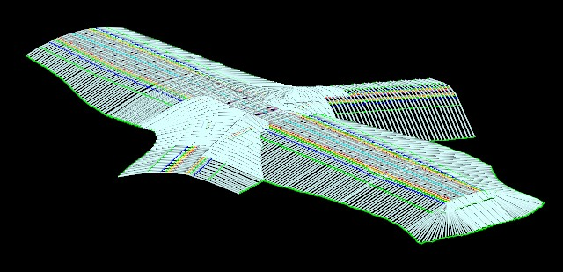
3DM for Construction
Project represented in 3D, with accuracy and precision
Rotated, tilted, and manipulated to provide varying views
Perform “clash” analysis, easily see surface “spikes”
Improved quality with quantity takeoffs
Digital Terrain Model (DTM) converted to LandXML for Automated Machine Guidance (AMG)

Slide 3
3DM Benefits
For Cabinet
Lower bids
Material cost savings
Uniformity
For Contractors
Better, more accurate bids
Stakeless construction
Increased productivity and efficiency, lower costs
Eliminate 3rd party reverse engineering
For Designers
Identification of potential constructability issues earlier in the design process
Better value to clients and stakeholders
Visual model verification provides design QC

Slide 4
3DM: MAP-21 Provisions
Section 1304 – Innovative Project Delivery Methods
Projects including use of innovative technology may be eligible for greater federal share of funding
Examples include “digital 3-dimensional modeling techniques”
Section 1503 – Project Approval and Oversight
The Secretary “shall encourage the use of advanced modeling technologies during environmental, planning, financial management, design, simulation, and construction processes of [federal-aid] projects.”
Compile information and industry best practices
Disseminate information and best practices to state DOTs
Develop and publish a comprehensive plan

Slide 5
FHWA Role on 3DM
Three-dimensional engineered models for construction (or just 3D models) are among a few select technologies being promoted by the FHWA Every Day Counts program
Our focus is on helping owner-agencies, designers, and construction contractors with little or no experience in 3D engineered models get started in implementing this technology

Slide 6
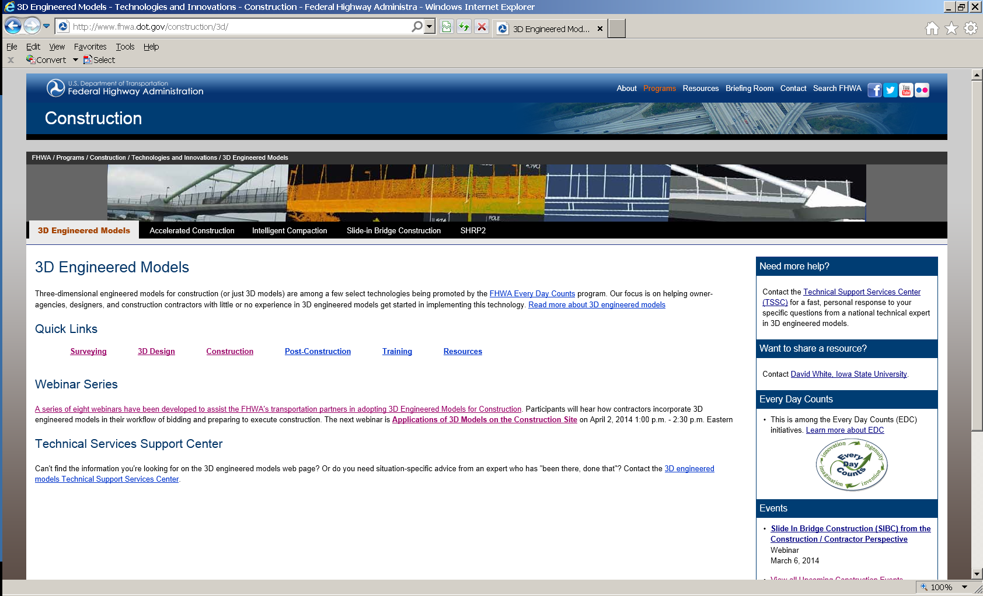
Additional Resources

